Slide 1

English at BCAT Mrs. Chapman 2014 - 2015

Slide 2

About Me
Cave Spring High School Class of 2002
Bachelors from Clemson in Communication
Masters from Radford in English/Education
8th Year Teaching (3rd at BCAT)
Married to Jeff
Momma to Sam

Slide 3

SIX WORD MEMOIRS
Teacher-Mom, life’s crazy; still smiling

Slide 4
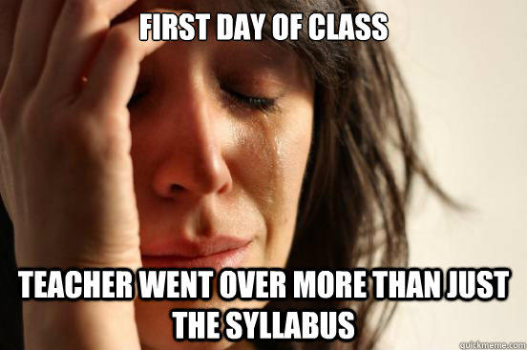

Slide 5
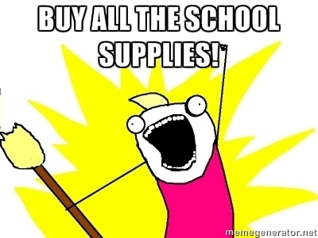
Class Materials:
Composition Notebook
1½” three-ring binder
Package of 5 – tab dividers
Notebook paper
Pens (blue or black ink)
Highlighters*
Post-it Notes*
Tissues*
Keurig Donations* (Juniors Only)
*Optional

Slide 6
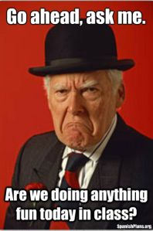
Routines & Lesson Plans
Class time will be a combination of direct instruction, independent practice, class discussion, and group activities.
Writing assignments at least every fifth class.
SAT Vocabulary Quizzes (bi-weekly)
Monthly Current Events/ Article Analysis
Most reading will be completed OUTSIDE of class.
ALL LESSON PLANS & ASSIGNMENTS POSTED ON BLACKBOARD & IN THE CLASSROOM WEEKLY.

Slide 7

Class Rules:
R-E-S-P-E-C-T

Slide 8
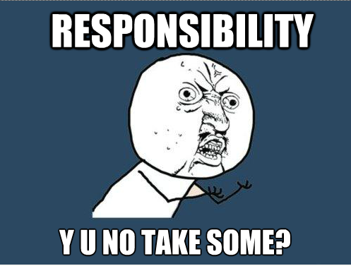
Class Rules:
2. Responsibility

Slide 9
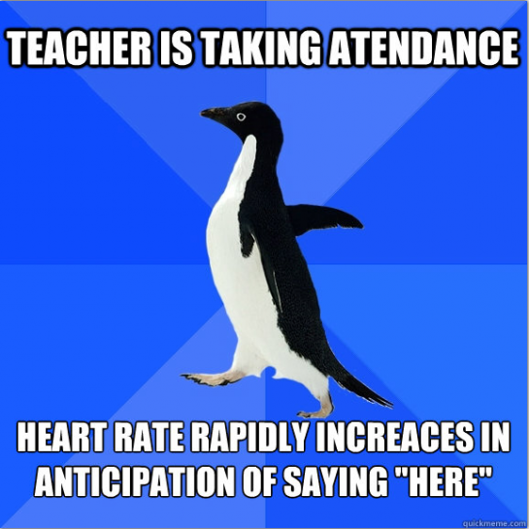
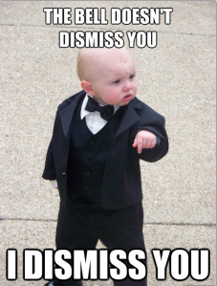
Class Rules:
3. Attendance

Slide 10
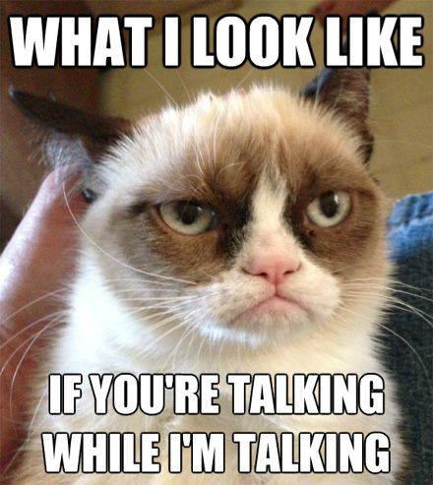
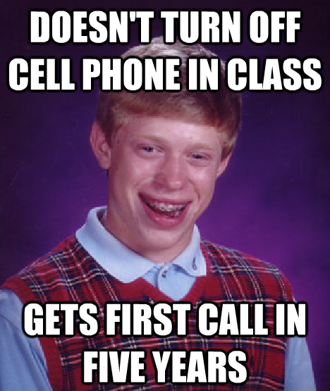
Class Rules:
4. Attention

Slide 11
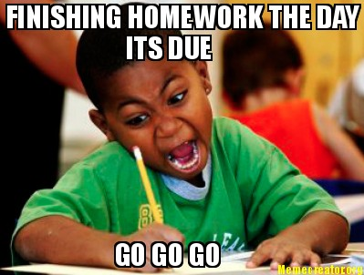
Homework
Designed to prepare students for class assignments and/or extend learning beyond the classroom.
Students should expect some out-of-class work in the form of larger projects or assignments to assess skills and knowledge over long-range time period. In addition, much of your reading will be done OUTSIDE of class.
No specific “Homework Grade.”

Slide 12
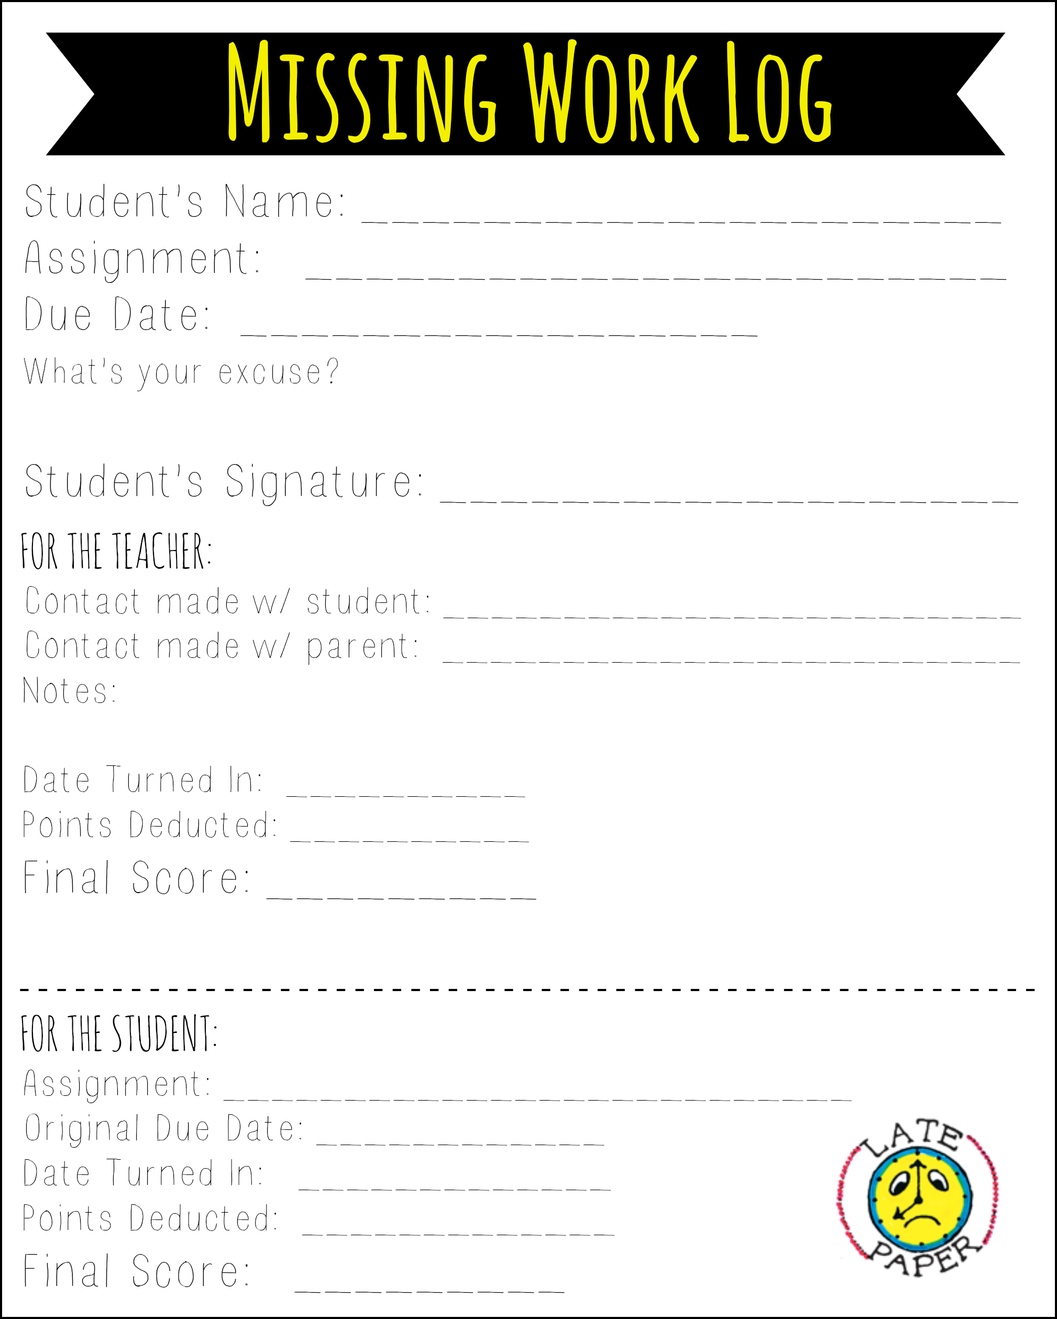
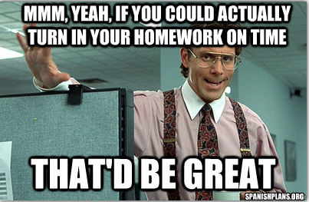
Late Work
Students must turn in a “Missing Work Log” in lieu of the assignment.
10% of points deducted for each day late.
Parents contacted on major assignments OR when missing work exceeds three assignments.

Slide 13
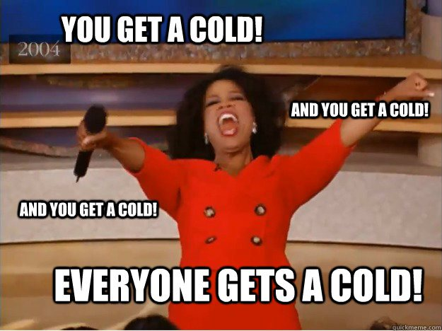
Make-up Work
Responsibility of the student to check Blackboard & “Make-up File” when absent.
Work should be made up within one day for each class day missed.

Slide 14

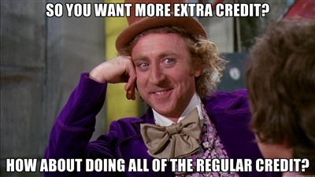
Assessment & Grading
Assessment will be a combination of participation, test/quizzes, projects, presentations, and writing assignments.
Grades calculated using a TOTAL POINTS system.
All grades will be posted on BB as they are updated.
STUDENTS MUST MAINTAIN A ‘C’ AVERAGE TO STAY IN THE PROGRAM.

Slide 15
